Slide 1



Introduction to PPI networks
Tamás Korcsmáros
Network Biology Group
http://netbiol.elte.hu

Slide 2
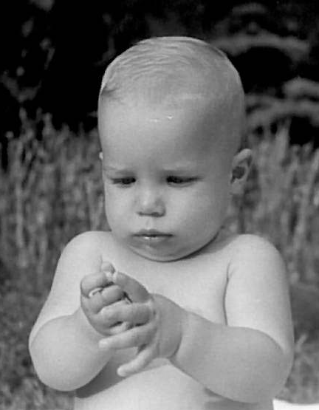
Early research career
Started as a high-school research student
4 years at a medical biochemistry lab
MSc in biochemistry and molecular biology
PhD on metazoan signalling networks

Slide 3
Previous research interests and results
Signalling networks (cross-talks, multi-pathway proteins and their regulations)
Cancer-related networks (systems-level changes)
Network-related drug discovery and design (propose novel targets and summarize concepts)
NRF2-ome (interactome and regulome of a master antioxidant transcription factor)
Autophagy regulation (novel regulators)
Research + Service

Slide 4
Current research interests
Regulation of autophagy by intracellular bacterial species in the gut
Reconstruction of a Salmonella molecular network
Develop workflows to analyze host-pathogen interactions
In silico + In vitro

Slide 5



Slide 6
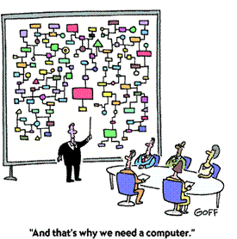

Slide 7
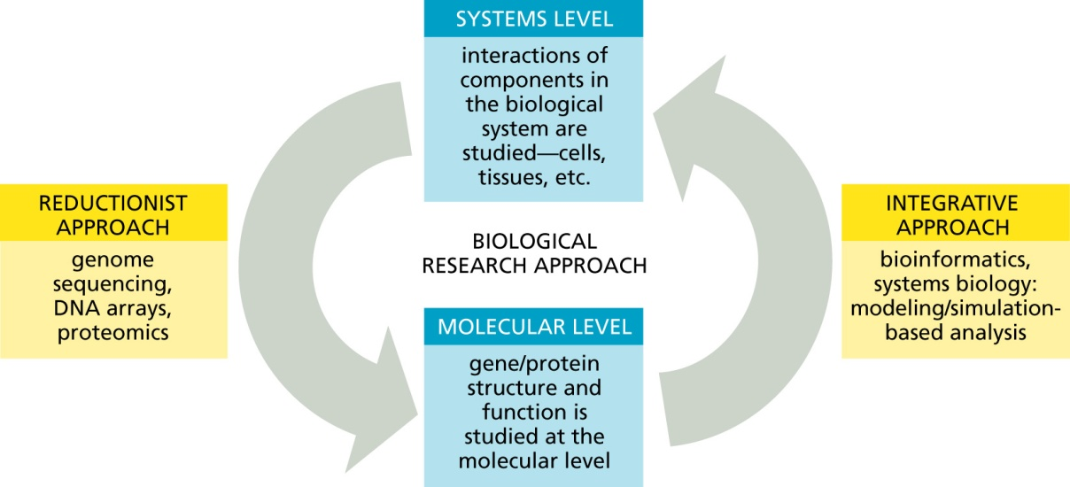
Approaches

Slide 8
Networks

Slide 9
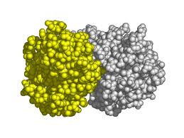
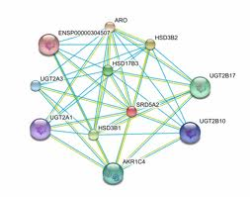
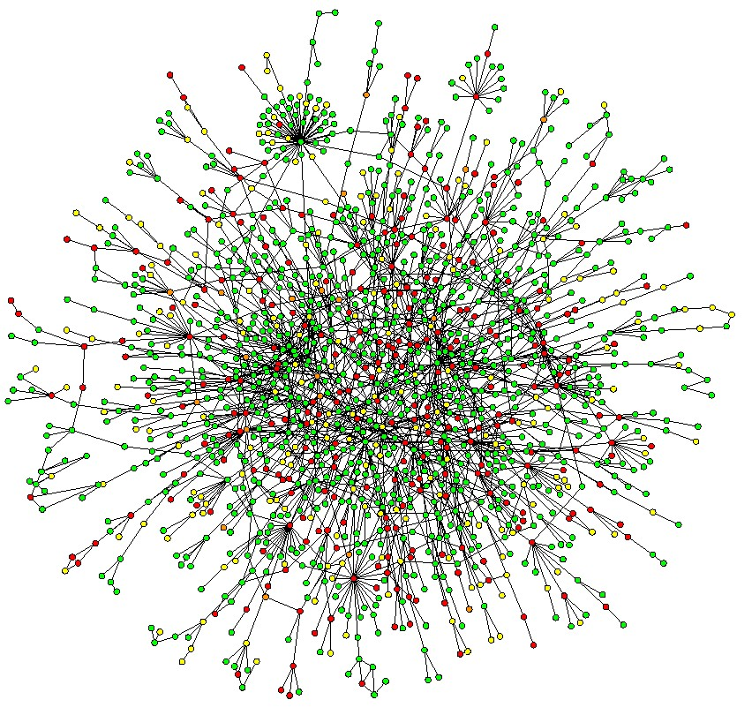
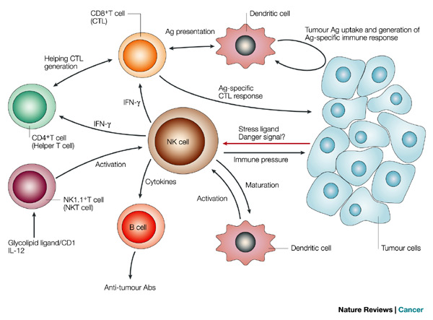
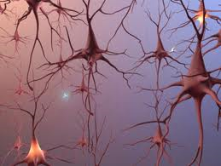
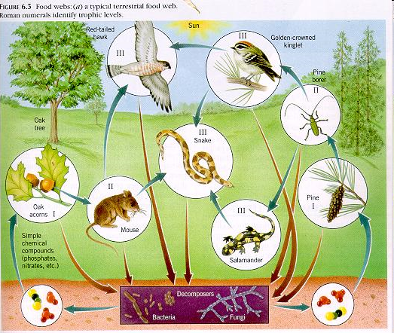
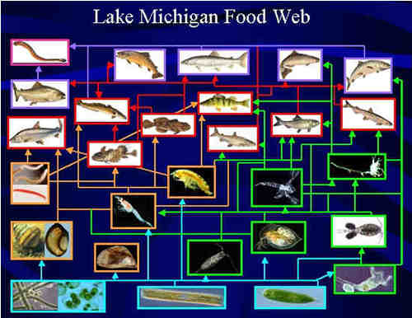
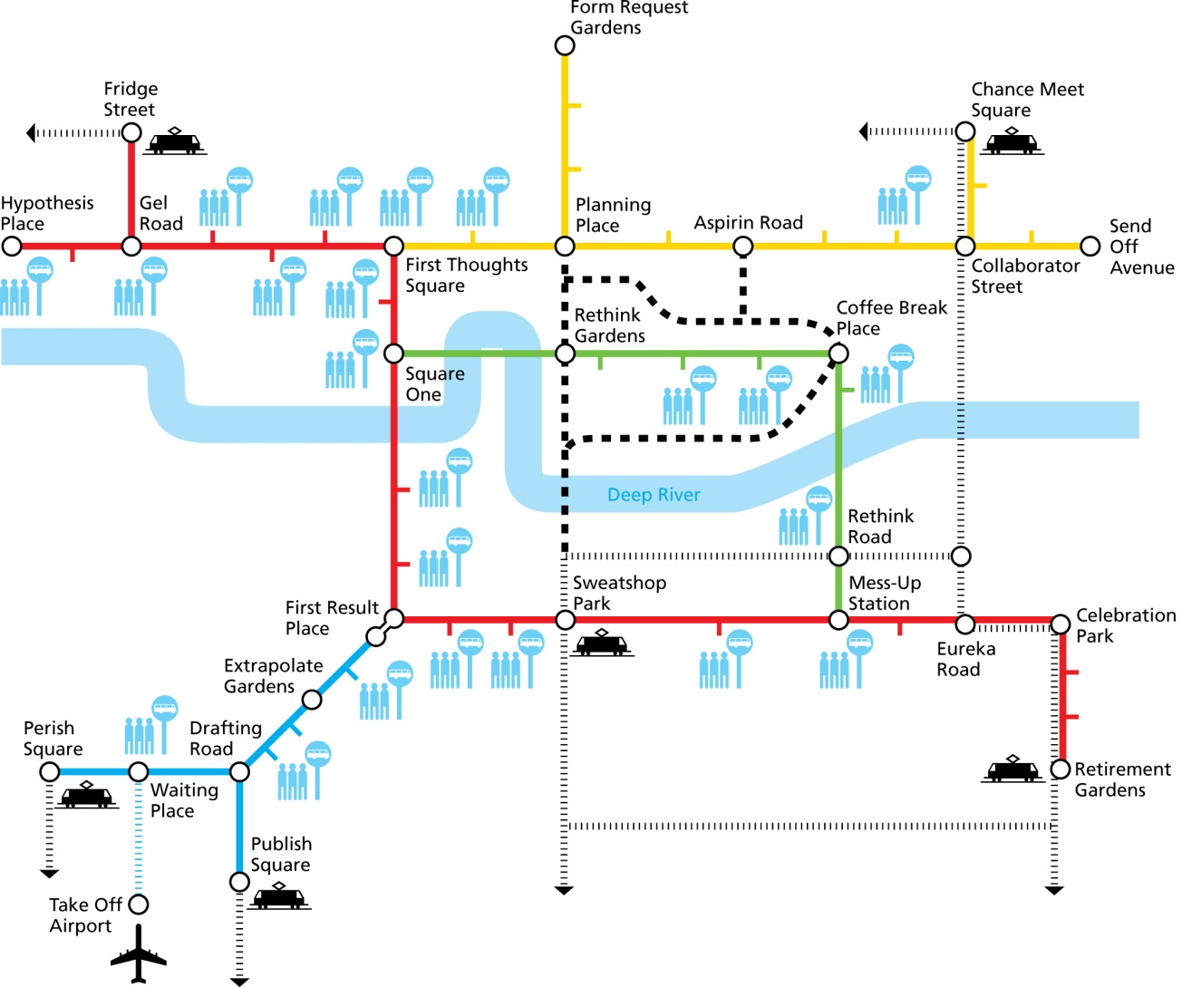
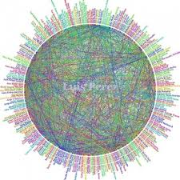


Slide 10
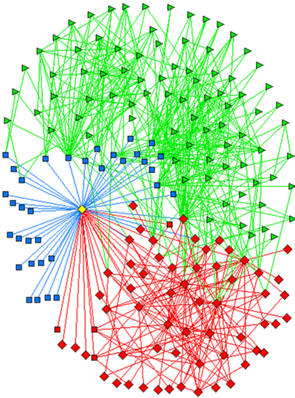
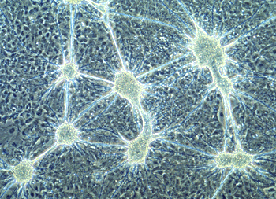
Networks are embedded to each other
Cellular network
fehérjehálózat

Slide 11
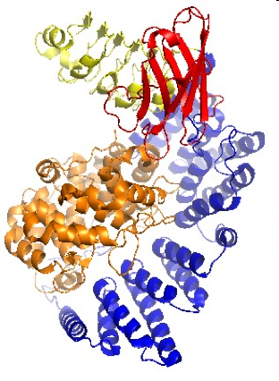
Networks are embedded to each other
Aminoacid network

Slide 12
Example of a PPI Network
>80% of proteins are all connected in one giant cluster of PPI network
Small-world effect
Nodes – proteins
Edges – interactions

Slide 13


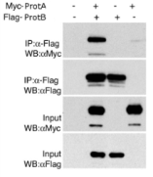
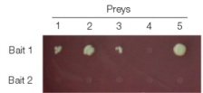

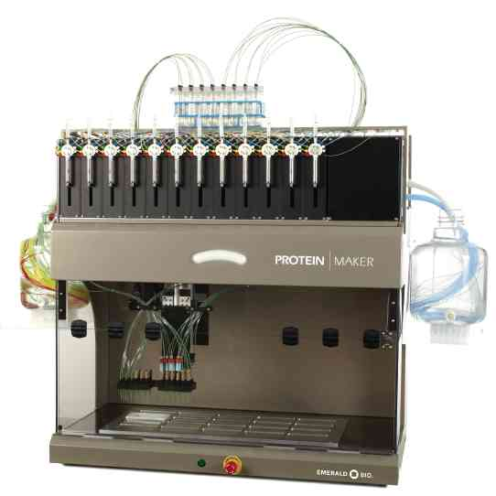
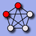

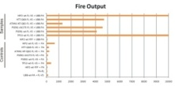
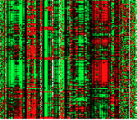


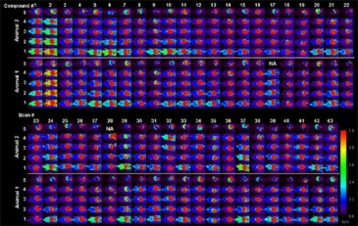
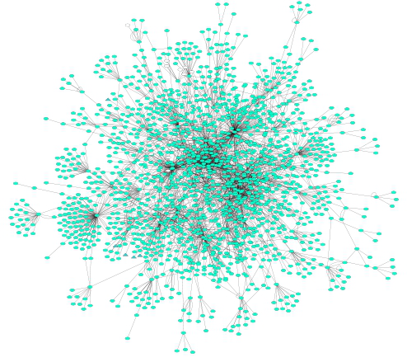
PPI Network analysis: building a network
primary databases
experimental data
meta-databases and predictive databases
Challenges:
Identifiers
Redundancies
Selection of the data
Type
Quality
Mapping external information

Slide 14
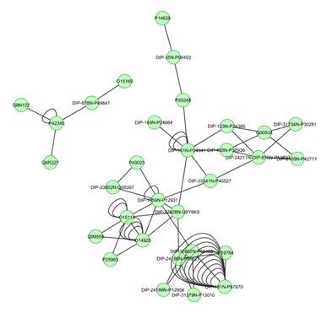
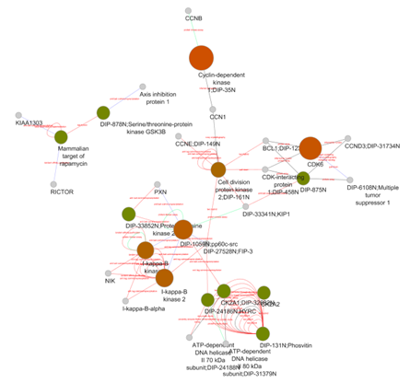
PPI Network analysis: filtering and enriching your data
Confidence filtering
Detection method
Number of publications
Confidence score
...
Overlaying external information
Expression data
Protein abundance
Enzymatic assay values
...

Slide 15
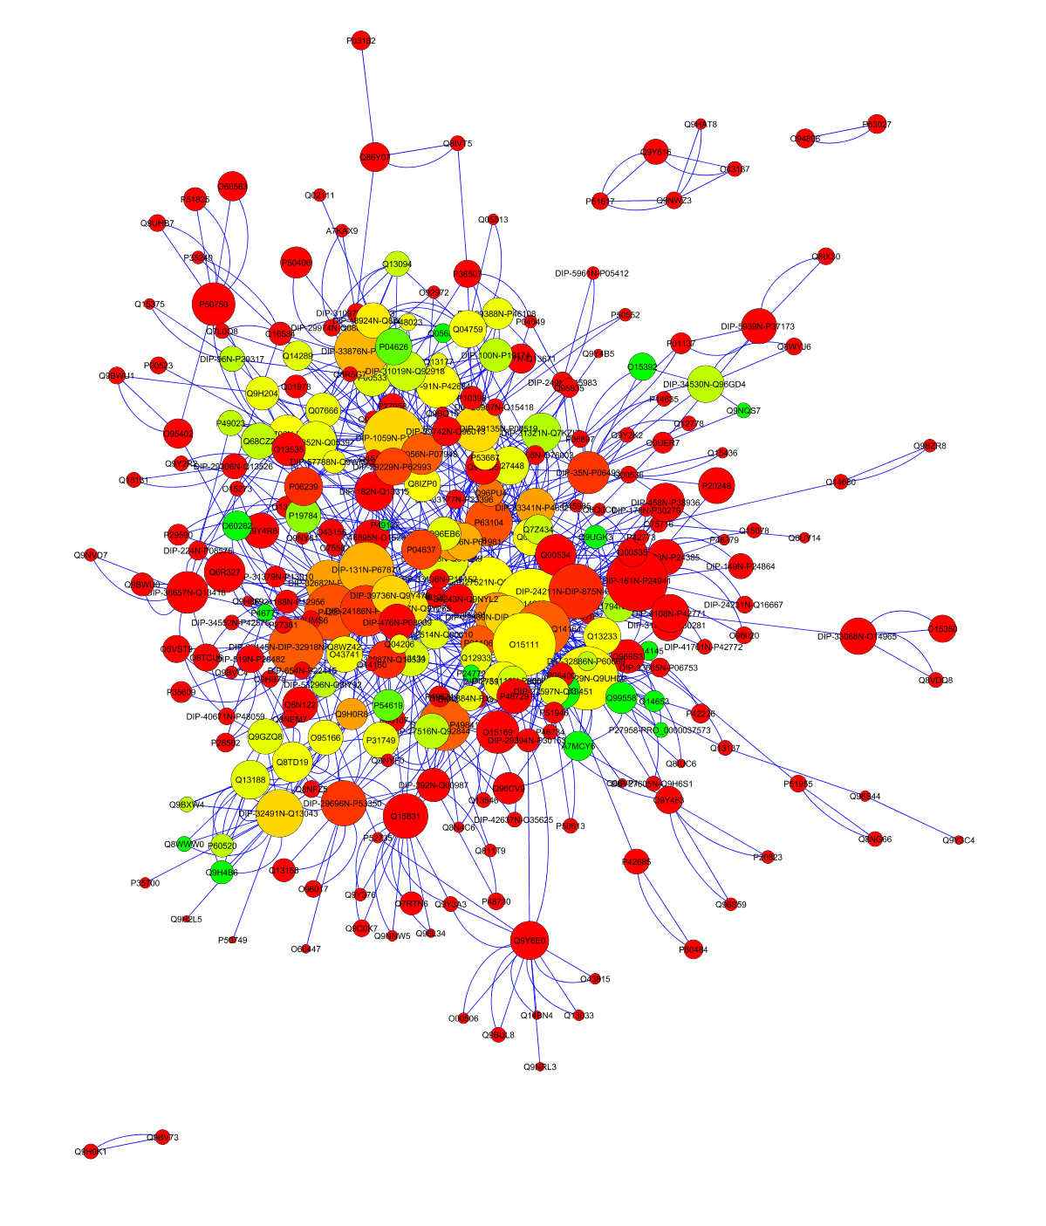
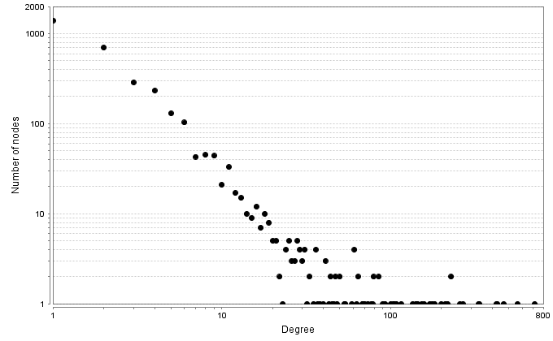
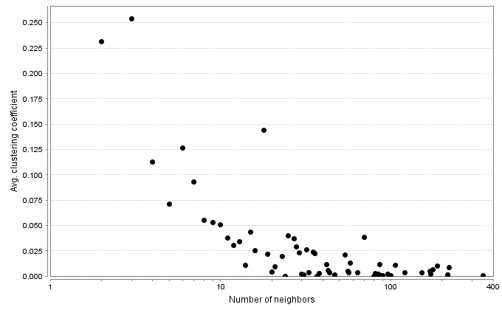
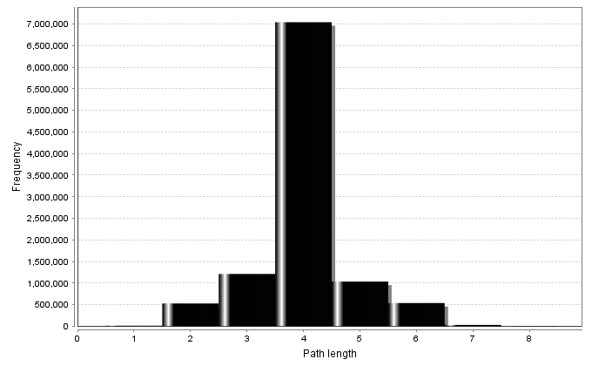
PPI Network topological analysis
Degree distribution
Average clustering coefficient distribution
Shortest path length distribution

Slide 16
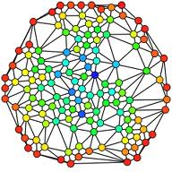
PPI Network topological analysis
Betweenness centrality:
Measure of a node's centrality in a network.
Number of shortest paths from every end of the network that pass through that node.
Gives a good estimation of the importance of a node (protein) in a network (signalling, scaffolding…).
Red: BC=0
Blue: BC=max
Green: BC= low
Red: BC= high

Slide 17
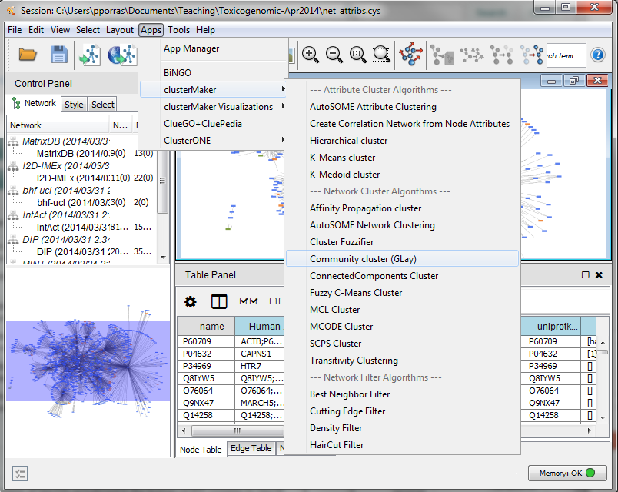
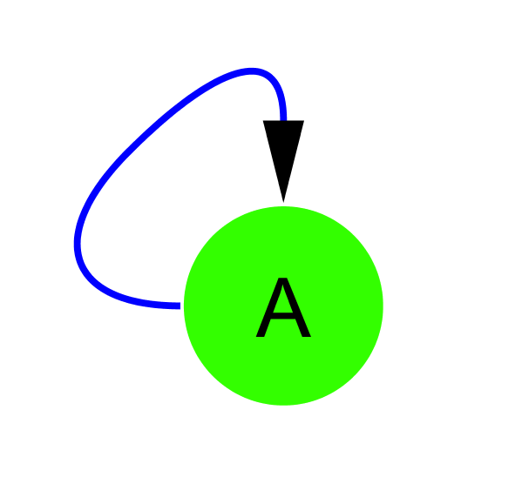
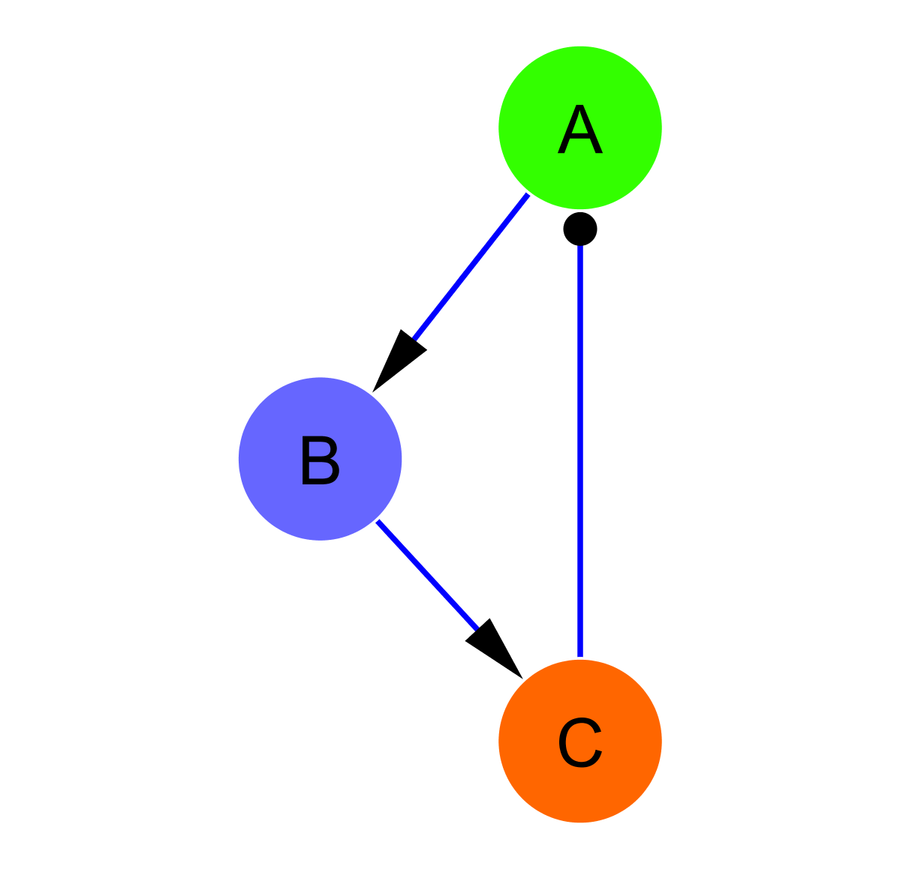
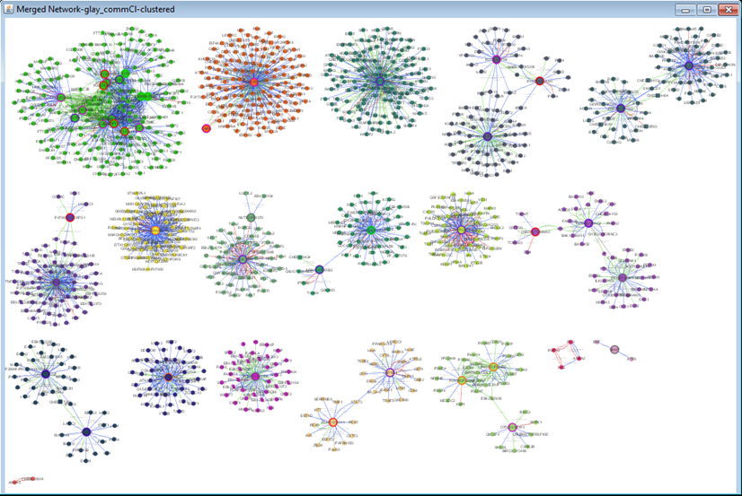
PPI Network topological analysis: cluster and motif search
Clustering search
Common motifs

Slide 18
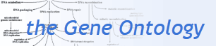
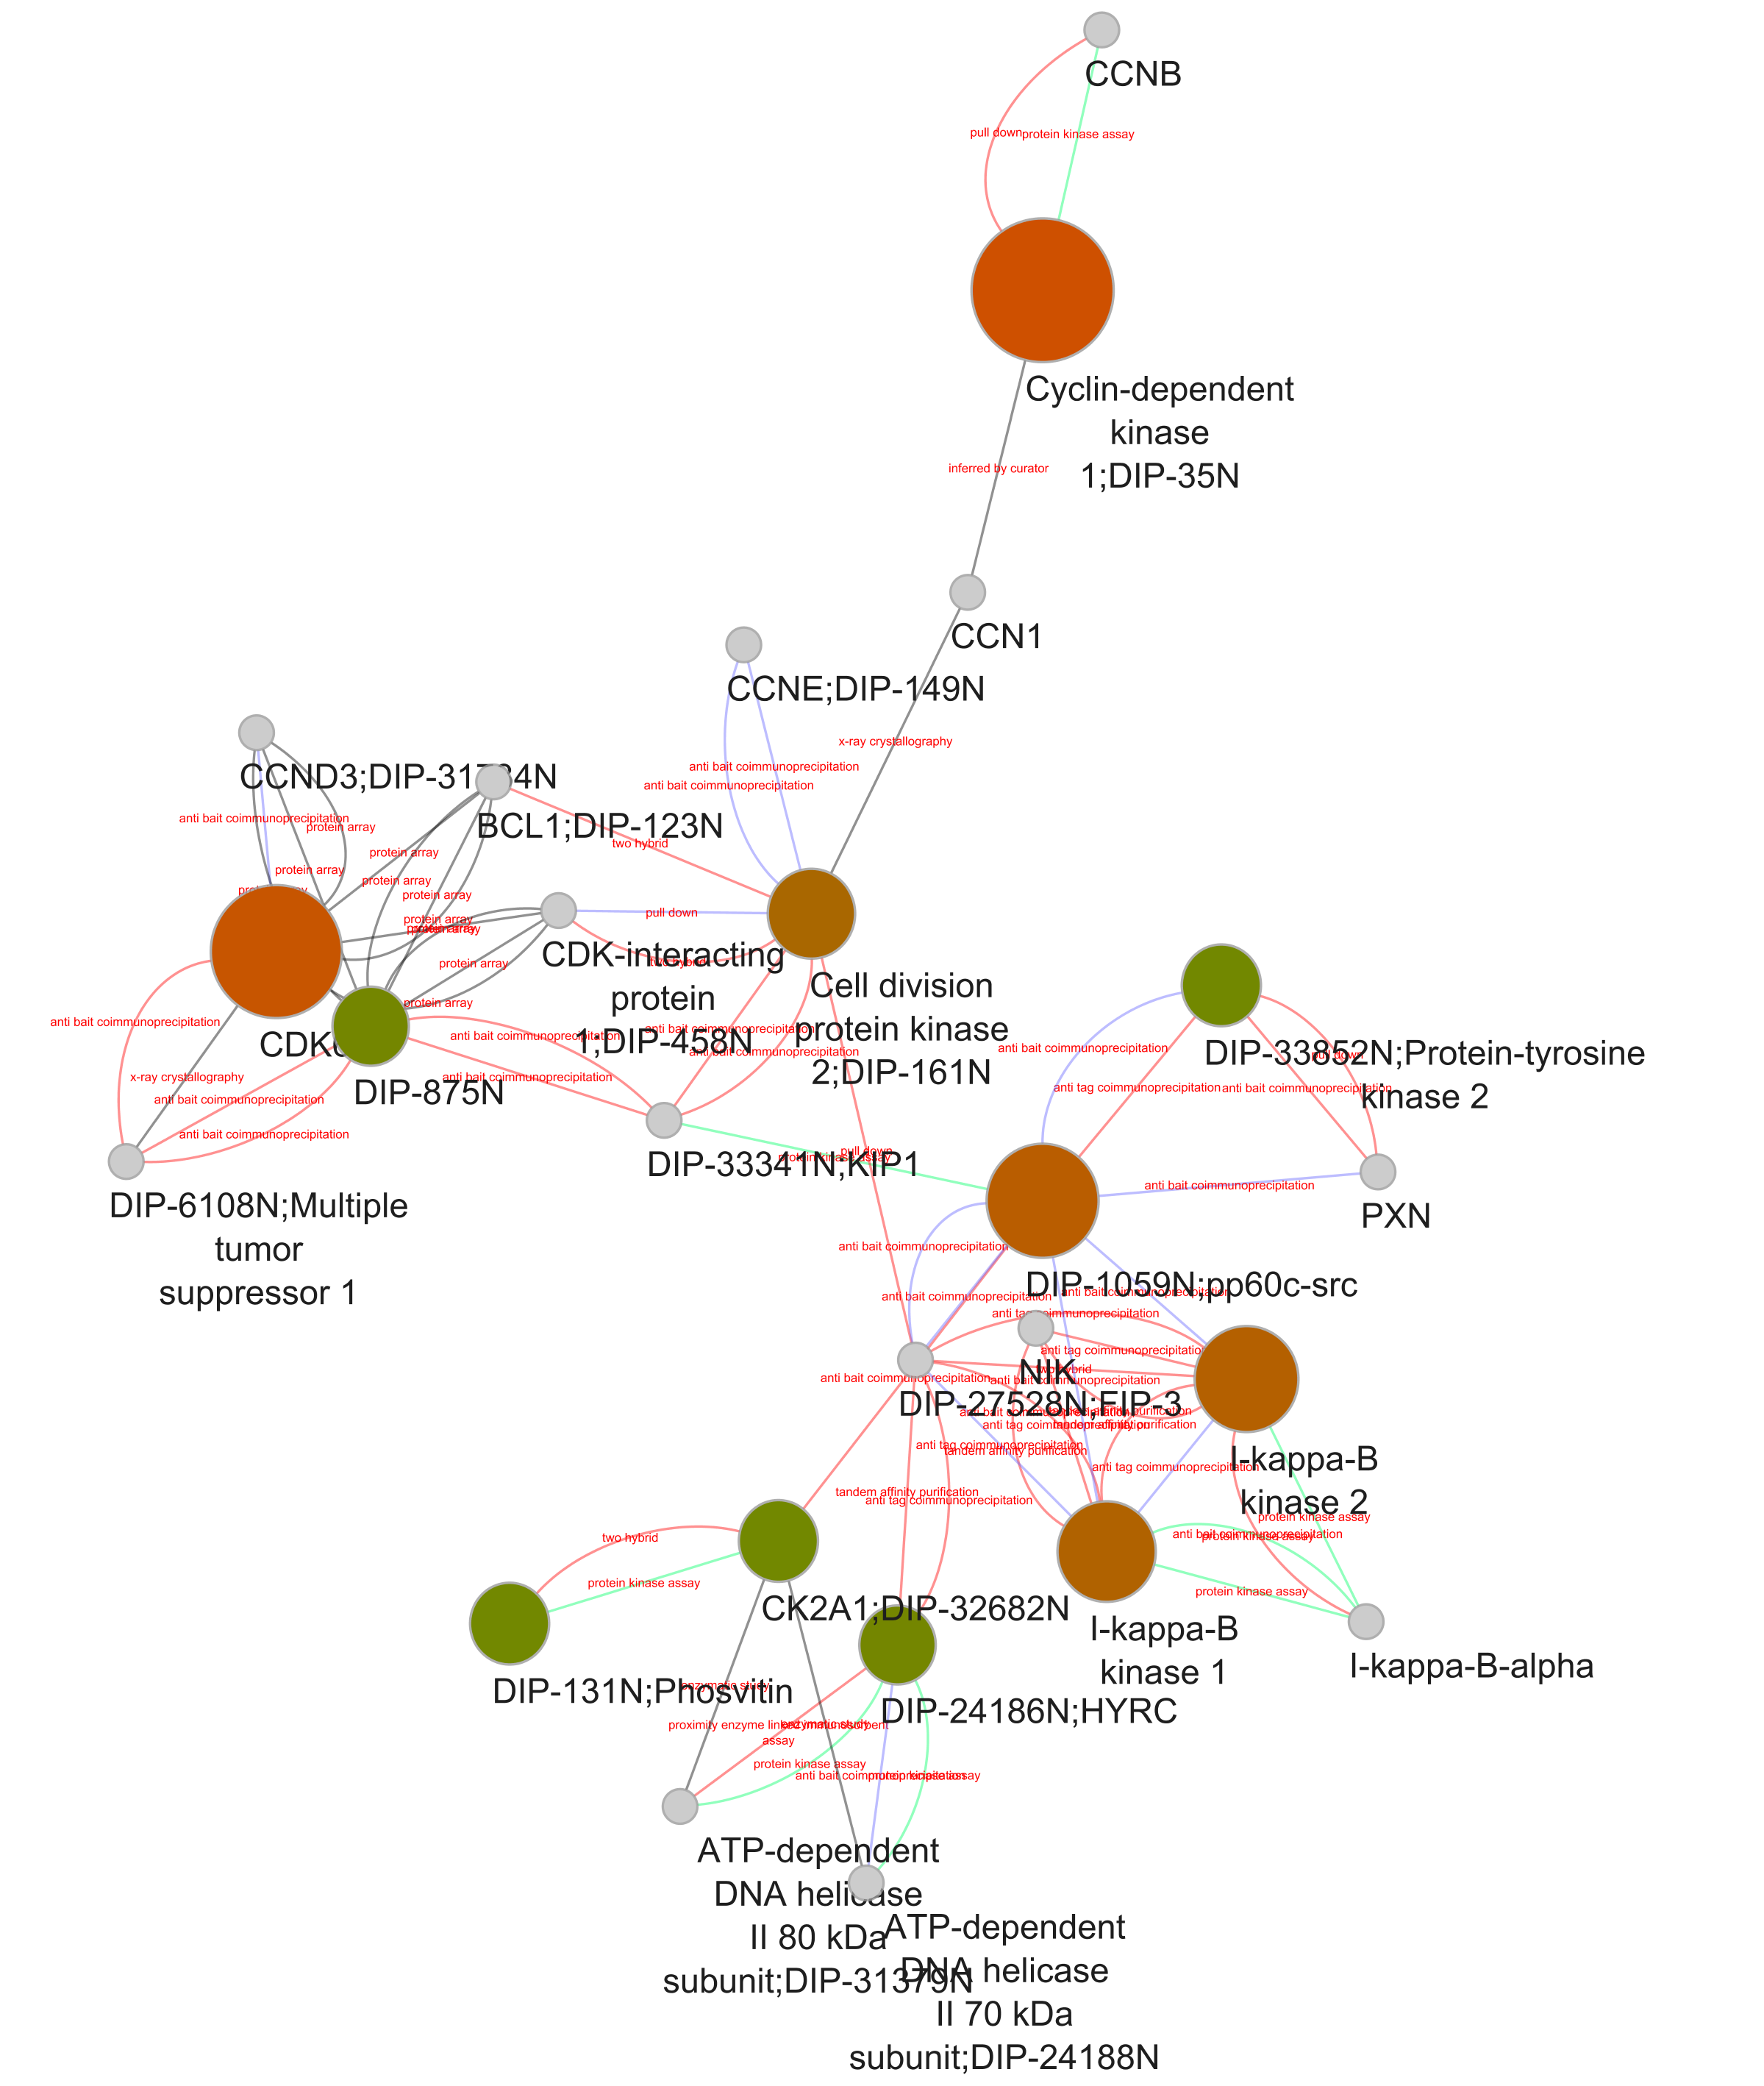
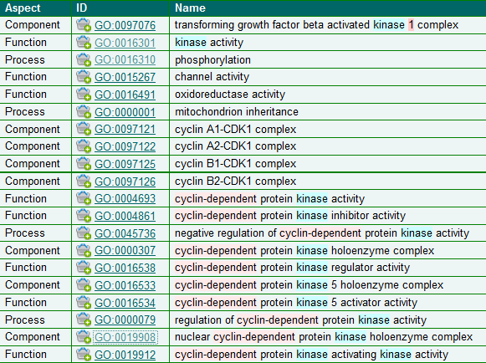

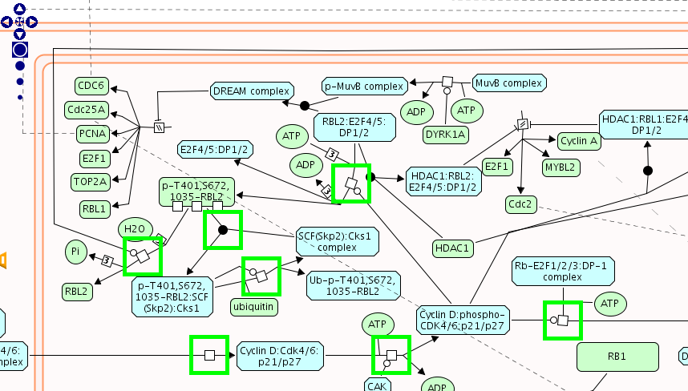
PPI Network analysis: annotation enrichment analysis
GO:0019908:
nuclear cyclin-dependent protein kinase holoenzyme complex
REACT_821.2:
Cyclin D associated events in G1

Slide 19
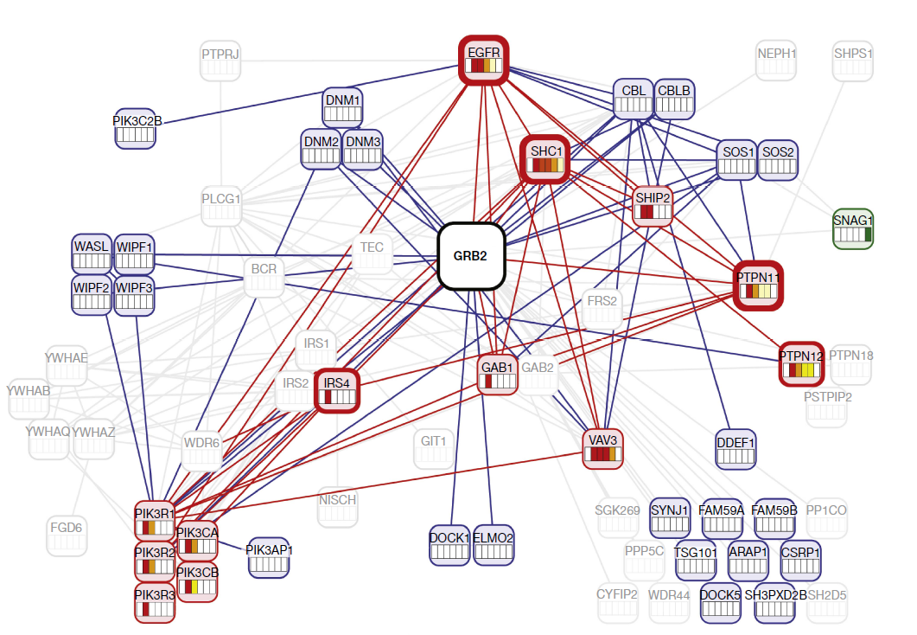
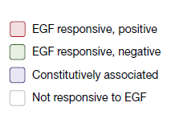
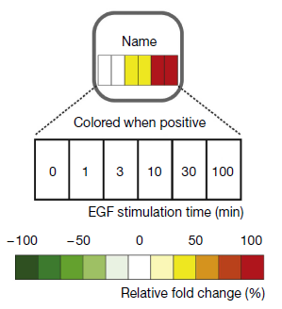
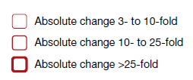
PPI Network representation challenges
Blisson et al., 2011, Nature Biotechnology, PMID: 21706016.

Slide 20
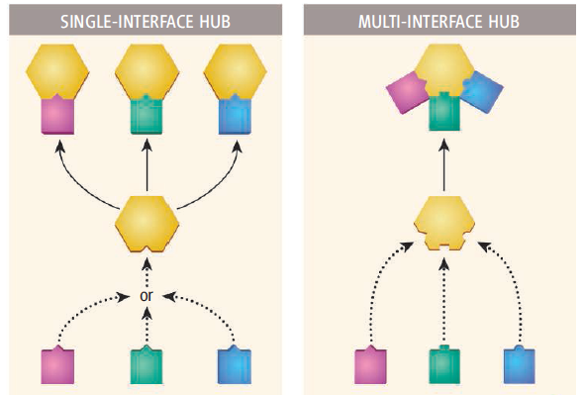
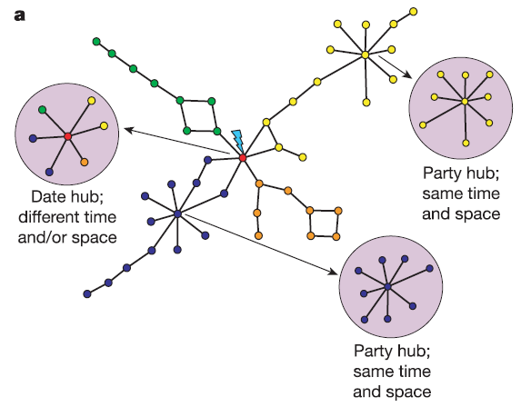
Hubs – high degre nodes
Kim et al., Science, 2006
Han et al., Science, 2005

Slide 21
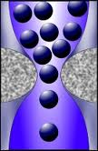
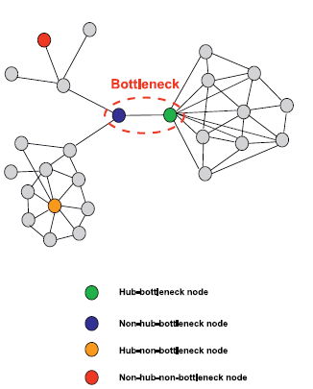
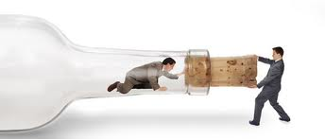


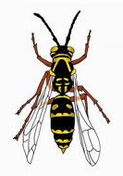
Bottleneck proteins

Slide 22
Topological features and network dynamics
Creative elements few links to hub (nonhub-bottlenecks), surprising control, flexible
non-predictable
Distribution centers hub, special signal distribution,
predictable
Problem solvers specialized tasks, predictable
Csermely, Trends in Biol. Sciences (2007)

Slide 23
How to access the data?

Slide 24
Molecular interaction information
Ideally
Reality
DB
DB
DB
DB
DB
I
I
I
I
I
Database
I
Interface
User

Slide 25
Data integration
Combining data residing in different sources
… providing users with a unified view of these data.
Ideally
Reality
Compromise
DB
DB
DB
DB
DB
DB
DB
DB
DB
I
I
I
I
I
STANDARDS AND ONTOLOGIES
I
Database
I
Interface
User

Slide 26

The danger with standards…
From xkcd: http://xkcd.com/927/

Slide 27
Data integration problems
Many data resources
Many to maintain
New appearing
Just 20% has a sustained future*
Not easy to find them
Different query interfaces
Variable results
Formats
Schemas
Controlled vocabularies
Minimum information guidelines
Redundancy
Inconsistency
data integration?
* Merali et al., 2005, Nature, PMID: 15973369.

Slide 28
Collaboration among data providers
More data coverage
Less redundancy
Less inconsistency
Better data management
Access, exchange, sharing, portability, interoperability, annotation, comparison, verification, representation, integration, reusability.
IntAct
PRIDE
EMBL
…
…
InnateDB
GPMDB
NCBI
DDBJ
MINT
Tranche
DIP
PeptideAtlas
Nucleotide sequences
INSDC
Molecular interactions
IMEx
Protein indentifications
ProteomeXchange

Slide 29


Standards
PSI-MI standards
Common identifiers
Controlled vocabularies
Common formats
Common schemas
Minimum information guidelines
Common query interfaces
www.psidev.info/MI
Control vocabulary
Schema
Format
Identifiers
Reporting
guideline
Data distribution
Notes:
The Molecular Interactions workgroup is concentrating on:
improving the annotation and representation of molecular interaction data wherever it is published, be this in journal articles, authors web-sites or public domain databases
improving the accessibility of molecular interaction data to the user community. By using a common standard data can be downloaded from multiple sources and easily combined using a single parser

Slide 30

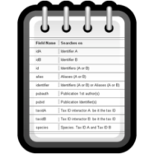




Unified query client: PSICQUIC
www.ebi.ac.uk/Tools/webservices/psicquic/view/main.xhtml
PSI-MI
MIQL
Interactions
Query
input
output
PSICQUIC
PSICQUIC
Service A
PSICQUIC
Service B
PSICQUIC
Service C
PSICQUIC
Registry

Slide 31




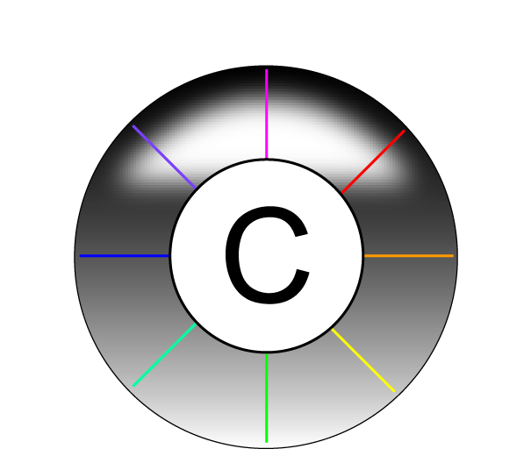





Examples of services using PSICQUIC
www.phisto.org
www.reactome.org
www.cytoscape.org
www.genemania.org
http://mentha.uniroma2.it
http://clipserve.clip.ubc.ca/topfind
http://cbdm.mdc-berlin.de/tools/hippie
www.ebi.ac.uk/Tools/webservices/psicquic/view/main.xhtml
www.bioconductor.org/packages/release/bioc/html/PSICQUIC.html

Slide 32
Where can we access the data?

Slide 33
PPI database types

Slide 34
PPI types
Strength
Direction
Causality/sign
Symmetry
Spatiotemporal

Slide 35

http://interactome.dfci.harvard.edu

Slide 36

http://interactome.dfci.harvard.edu

Slide 37


http://www.droidb.org

Slide 38

http://hprd.org

Slide 39

http://string.embl.de

Slide 40

http://thebiogrid.org

Slide 41




http://thebiogrid.org

Slide 42

ebi.ac.uk/intact

Slide 43

ebi.ac.uk/intact

Slide 44

ebi.ac.uk/intact

Slide 45

ebi.ac.uk/intact

Slide 46


Slide 47
PPIs and medicine

Slide 48
classic view of drug action
drug
target
therapeutic effect
off
target
side effect
network view of drug action
target 1
target 2
therapeutic effects
+ side effects
drug
target 3
target 4
Csermely, Korcsmaros et al., Pharmacol & Therap 138:333-408 (2013)

Slide 49

Drug design strategies
Csermely, Korcsmaros et al., Pharmacol & Therap 138:333-408 (2013)

Slide 50

Multi-target drugs
Csermely et al, Trends Pharmacol Sci 26:178
Notes:
50

Slide 51


Allo-network drugs
hit of intra-
cellular paths
Nussinov et al, Trends Pharmacol Sci 32:686-93
Notes:
51

Slide 52
Network-based drug target options
hubs
hub-connections
overlapping elements
bridges
Korcsmáros et al., Exp. Op. Drug Discov. 2:1 (2007)

Slide 53
Network-based drug target options in signalling networks
hubs
hub-connections
central components of pathways
cross-talks
overlapping elements
bridges
multi-linker
linker
multi-pathway proteins

Slide 54

Drug-drug target networks

Slide 55


Disease and disease gene networks
Disease network
Disease gene network
Nodes: Diseases
coloured based on disease-types
size proportional with the nr of disease genes
Edges: common disease gene
coloured based on disease-types, grey represents connection between different disease-types,
width proportional to the nr of common genes
Nodes: Disease genes
coloured based on disease-types
size proportional with the nr of diseases the gene is related to
Edges: common disease
coloured based on disease-types, grey represents connection between different disease-types of the same genes,
width proportional to the nr of common genes

Slide 56

We’ll hear it after the break
How can we combine PPIs and medical data?

Slide 57


Thank you for your attention!
Special thanks to
Pablo Porras
Peter Csermely
Tamas.Korcsmaros@tgac.ac.uk

